Slide 1
Intercultural Collaboration in the Work Environment
Virtual Team Project
Group 7
Emily McNamara, Nikita Punit, Samantha Nelson, Michael Sudol, Pedro Guarin Camargo

Slide 2
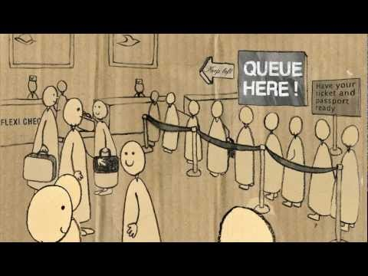
What is Intercultural Collaboration?
Intercultural collaboration is the ability to communicate and interact efficiently with people from different social and cultural backgrounds.
Intercultural collaboration plays a crucial role in determining the success or failure of any team work in an international organization.

Slide 3

Advantages of Intercultural Collaboration
Being able to expand business overseas and accessing foreign markets which could bring in better and unique products
Influences the advancement of communication technology such as translation tools in order to better understand one another and bring people from different cultures together
Lessens the restrictions of language and geographic barriers in order to achieve a common goal
Creates a foundation of understanding one another in order to lessen any tension between differing cultures, making professional interactions easier to manage

Slide 4

Disadvantages of Intercultural Collaboration
Possibility of misunderstandings due to unexpected reactions which leads to frustrations within the team
Not being able to understand the local cultural codes or taboos leading to feeling of exclusion
Sometimes miscommunication and misinterpretation of a message causes people of the local culture to feel confused

Slide 5
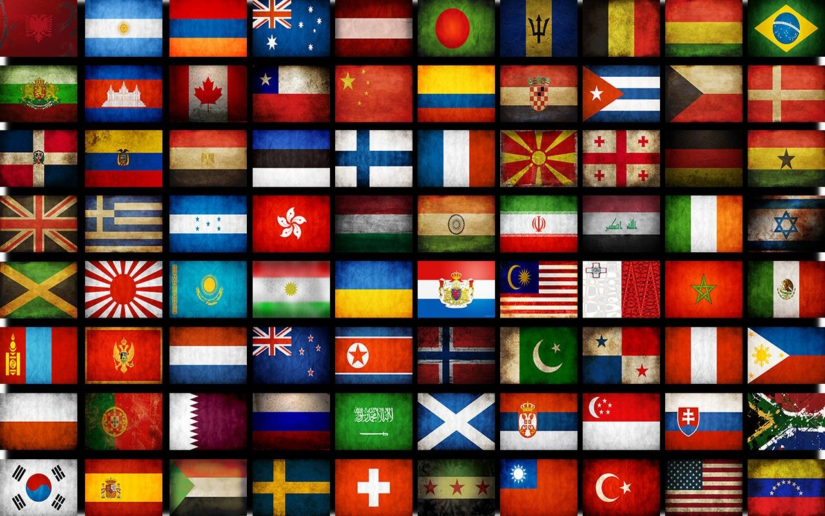
Example of a difficulty due to Intercultural Collaboration
“Making Sense of Intercultural Collaboration” by Allan Bird & Joyce S. Osland
French and Germans had different expectations about how to collaborate
When expectations are not met:
  A cultural incident occurs causing a negative reaction
  Usually followed by false attribution about other culture’s behavior
  Leads to loss of trust or inability to build a relationship

Slide 6

Ways to overcome difficulties
Cultural differences may create a barrier to trust
Individuals can learn to be perceived as trustworthy:
  1. Understanding cultural preferences - what trust and being trustworthy mean in the other culture
  2. Learning the expectations of trust-based behavior in that culture
  3. Matching those expectations in a consistent, dependable way

Slide 7

Cultural Metacognition & Affect-Based Trust in Creative Collaboration
Cultural Metacognition = an individual’s level of conscious cultural awareness & executive processing during cross-cultural interactions
3 studies :
  An assessment of managerial performance
  A social network survey
  A lab experiment involving a collaborative task
The studies yielded the following results:
  Managers higher in metacognitive cultural intelligence were rated as more effective in intercultural collaboration
  Managers lower in metacognitive cultural intelligence reported a lack of new sharing in their work environment
  Managers with higher metacognitive cultural intelligence produced great idea sharing & creative performance
  Individuals higher in cultural metacognitive are more likely to develop trust in their intercultural interactions & relationships

Slide 8
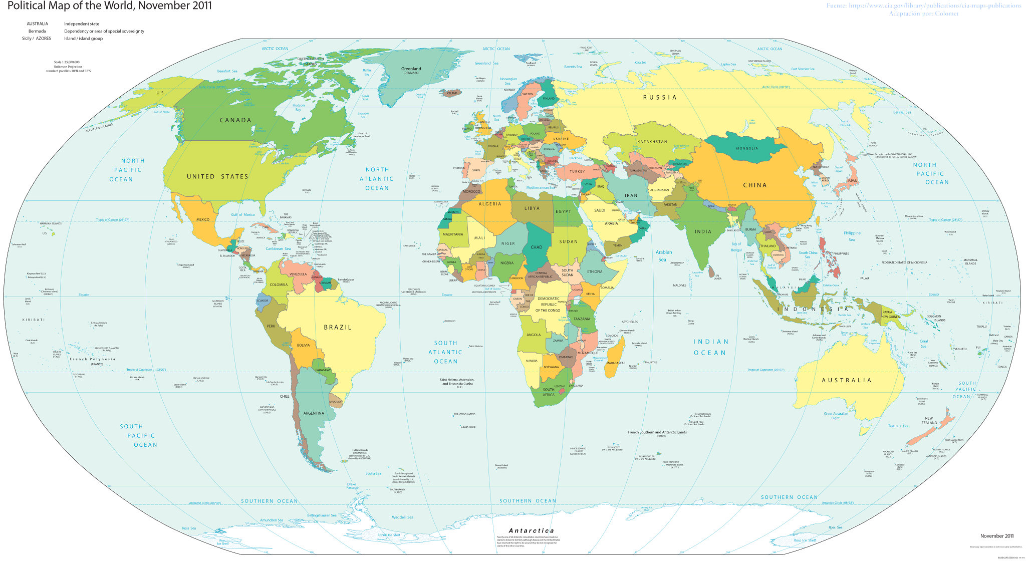
A Few Important Points:
Individuals should be more aware of their surroundings & the people that they work with
Individuals should be accustomed to the idea of diversity
Individuals should try & make people from different cultural backgrounds feel as comfortable as possible
  This will allow more friendly interactions & trustworthiness to occur
  They will feel comfortable to express their ideas & perspective on various situations

Slide 9
Positionality and reflexive interaction: a critical internationalist cultural studies approach to Intercultural Collaboration
Research was conducted with meda students exploring the place of formal curriculum in structuring interaction in collaborative group work, and in furnishing possibilities for mediative intervention as curriculum internationalisation.
The study did observations, interviews, questionnaires and a Frierean intervention.
The study drew on critical internationalist cultural studies perspectives to help students from a contextualised and critically positioned understanding of intercultural competences as a means to attain reflexive control over interaction patterns for inclusivity.

Slide 10
Findings
Students said ‘in some ways we are already belong to a kind of global culture’.
All the students found they need to engage more, and could benefit from learning inclusive communicative behaviors.
Language difficulties were also a finding, some students only spoke English as a second language or ‘cultural’ unwillingness to speak.
A general acceptance that differentiation emerged from group behavior, and with joint responsibility.
The students came to the conclusion that they all could improve on their communication skills.

Slide 11
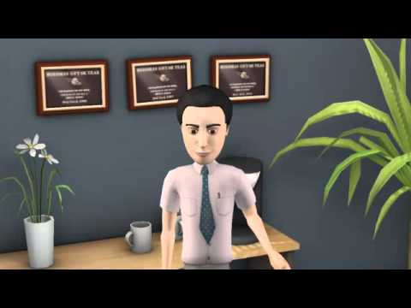
Intercultural team experiencing a culture clash in the workspace
This video by Global Dynamics demonstrates an intercultural team experiencing a culture clash at a workplace, which happens very often due to people with different cultures and viewpoints working together.
Real-life clashes like this occur in the workspace all the time.

Slide 12

Nesta Charity - Intercultural Collaboration
Nesta is a non-profit organization that works globally from the United Kingdom. The charity uses intercultural collaboration in their charitable business. Collaboration is important to them since their teams are made of people with different cultures that need to work together so everything operates smoothly.
Organizations and companies all over the world like Nesta include intercultural collaboration, today it is easy to do so with digital tools. Charities that work globally have to communicate with people all over the world in different countries, they need intercultural collaboration to work as a whole. Thousands of organizations use intercultural collaboration collaboration around the world, it is a big part of a team running smoothly and being successful.

Slide 13
Works Cited
https://www.nesta.org.uk/sites/default/files/collaboration_and_collective_impact_-_geoff_mulgan.pdf
https://www.youtube.com/watch?v=ryqNQnzAmBs
http://www.hbs.edu/faculty/Publication%20Files/11-127.pdf
https://www.youtube.com/watch?v=i2XKB-YSO7Q&t=1s
http://www.jstor.org/stable/40397648
https://www.youtube.com/watch?v=PSt_op3fQck
http://www.tandfonline.com/doi/pdf/10.1080/14703297.2016.1156010
https://www.youtube.com/watch?v=4bWpYNuRiEY
http://mail.langrid.org/publications/06/ishida-saint2006.pdf
https://www.youtube.com/watch?v=_y03t4_zGRs

